Slide 1

DM2397 – FYP2 PITCH Game Concept by Sri Sham Haran (155129R)

Slide 2

Game Concept
Darkrite
Single Player 2D tactical RPG with influence from JRPGs
Objective: Complete storyline
Utilise environment in combat
Team management

Slide 3
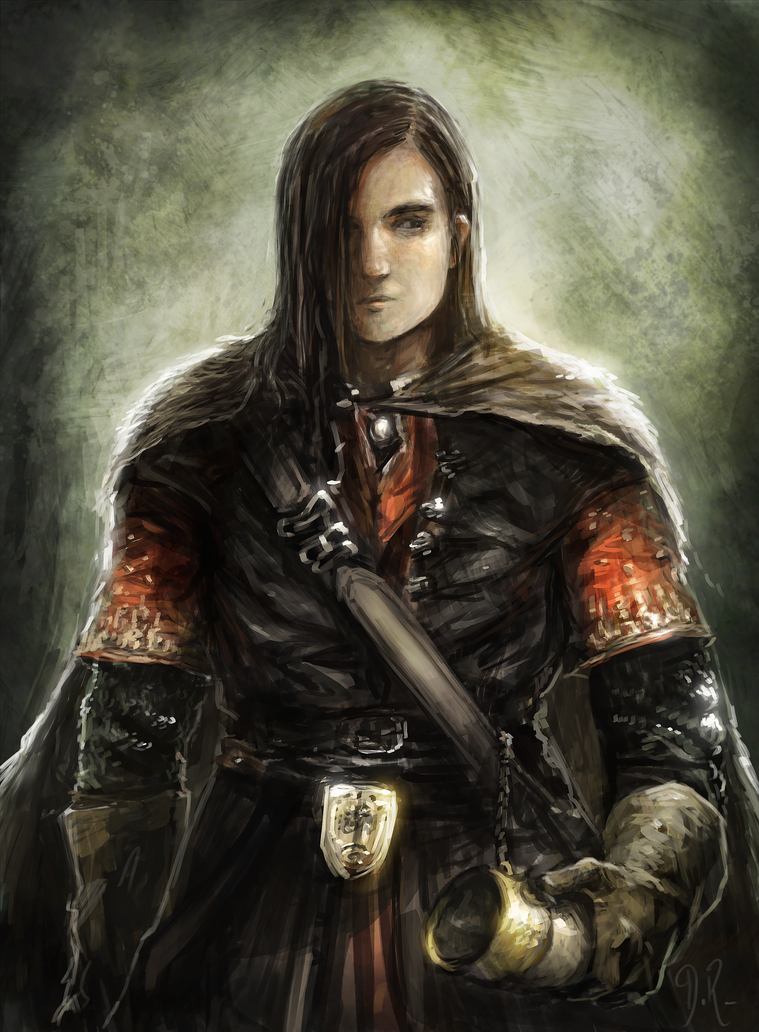
Unique Selling Points
Satisifies a sense of nostalgia for retro games and a sub-genre that has less devlopment on in the modern industry
Manipulate environment in combat
Team Management; recruitment and removal of members

Slide 4
Other Information
Target Audience : Teen gamers that enjoy strategical/tactical Role-Playing Games
Target Platform : Android
4 maps to advance through within story line

Slide 5
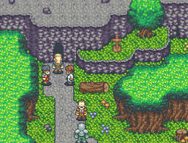
Game Logic
Turn based combat where various actions can be played.
Order of units is arranged by the Dexterity of the unit.
The higher the charisma, the better the unit you can recruit.
Environment – burning a tree of freezing water will have effects on units within the affected area

Slide 6
Level Design
2D Tiled maps with occasional puzzle elements to access other parts of the map.
Levels will consist of different types of areas such as towns, forests, villages, dungeons, etc.
Each town will be split into different districts – housing, commercial, etc.

Slide 7
Level Design
Forests, dungeons and non-inhabited areas:
will contain loot along the way. Loot at the end will be more rewarding
will have enemies. The higher the level of area is, the higher the level of the enemy unit is.
random chance of running into enemy unit while going around

Slide 8
Level Design
Combat:
Objective – Eliminate all enemy units within battlefield
3 to 4 Battlefields for each area to create diverse playing areas and gameplay
Handpicked, balanced amount of manipulatable environmental objects/areas
Celestial angel “regulates” battles to make game logic remain a part of storyline and immersion

Slide 9
Sustainability and Scalability
Recruit-able units have randomly generated values; therefore creating more diverse team formations in each play
Expansions to the storyline and lore can be developed and published to create a Franchise

Slide 10
Development and Production Schedule
Week | Milestone
Week 01 (17th Apr) | Ideation
Week 02 (24th Apr) | Game Concept & Design
Week 03 (1st May) | Project Framework & Storyline
Week 04 (8th May) | Controls, Movements and Interactions
Week 05 (15th May) | Event System
Week 06 (22nd May) | AI
Week 07 (29th May) | Battle System
Week 08 (5th June) | Inventory System
Week 09 (12th June) | Data Reader (Auto – Load Data for Quests, Events, AI, etc.), Data

Slide 11
Development and Production Schedule
Week | Milestone
Week 10 (19th June) | Level Design
Week 11 (26th June) | Environment Object and Effects
Week 12 (3rd July) | Playtest, Debug
Week 13 (10th May) | Debug, Additional tasks (Sound, screens etc)
Week 14 (17th May) | Polish
Week 15 (24th May) | Playtest, Debug
Week 16 (31st May) | Polish
Week 17 (7th Aug) | Final Presentation

Slide 12
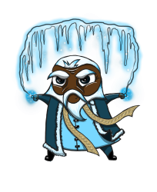
END
Questions?

